Slide 1
Distributed Slack Bus Power Flow
Bennett Wilson
Boyuan Xie

Slide 2
Content
Introduction
Economic Load Dispatch
Automatic Generation Control
Congestion Management
Conclusion

Slide 3
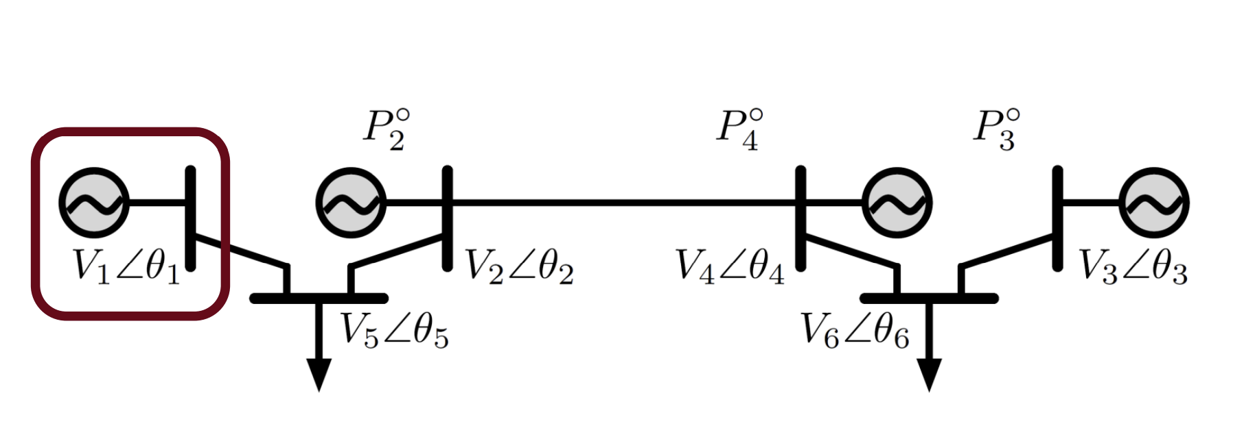
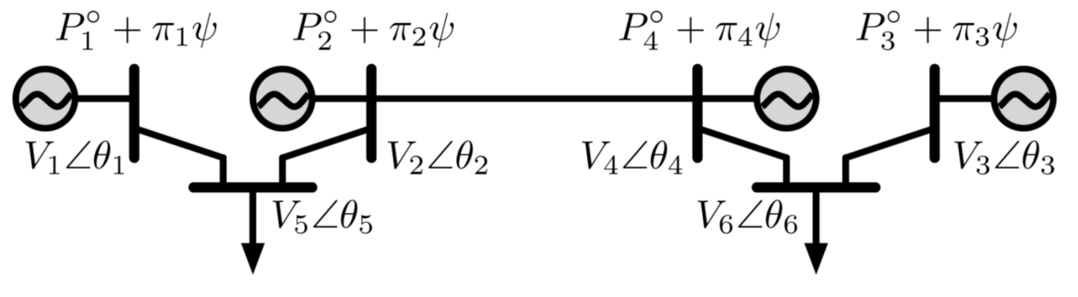
Slack Bus
Notes:
Before we go into the distributed slack bus algorithm, we want to go over the slack bus first. Here the single slack bus case is shown in the diagram above. We can easily observe that, the first generator, in the red box, has P unspecified. Actually, its Q is also unspecified. It is a V, theta generator bus(or a slack bus) due to two major reasons: First, it represents the reference angle. Second, it is used to balance the whole system’s losses( both P and Q). It is ok and very convenient in mathematical calculations, but in physical systems, it has drawbacks. One big problem is that, for an economic load dispatch problem, which I will mention in the next slide, leaving one generator’s PQ unspecified can never give the real equal incremental generator cost of the system.
To solve this issue, as early in 1971, there are scholars coming up with algorithms to solve power flow equations without the swing bus. The method is to introduce a new term in power flow equations, and one key element in the new term is the participation factor. As shown in the the diagram below. Here pi is the participation factor, and phi originally is the power that distributed to P1 in the single slack bus case, now it is redistributed to every generator with the participation factor.

Slide 4
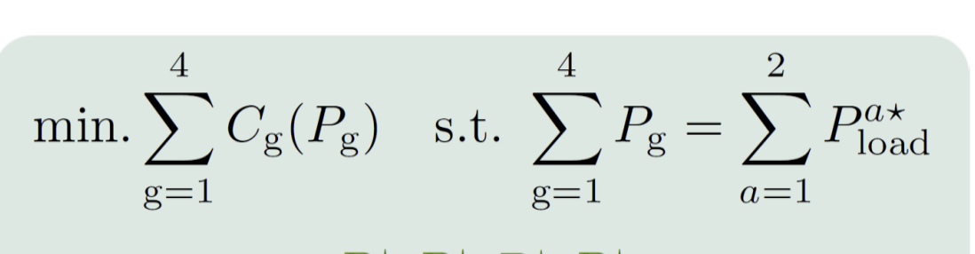
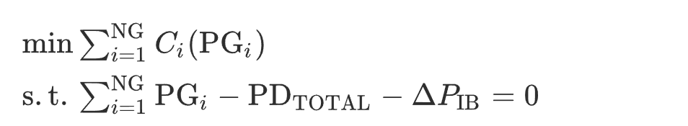
Economic Load Dispatch (ELD)
Conventional Economic Load Dispatch
Modified Economic Load Dispatch
Notes:
This slide shows the difference between the conventional economic load dispatch and the modified one. The important point here is that after introducing the distributed Slack Bus, we have a new delta P imbalance term in the load flow equation. This is the key to reduce the burden on slack bus and looking for a more optimal value for the system.
some new property:
Now The generation level of each generator is determined not in the ELD step, but after the power flow calculation.
The size of Jacobian matrix is not (n−1)×(n−1), but n×n, where n is the total number of buses in a power system, since the slack bus is included
The role of a slack bus as making up all losses of the power system is not necessary any more, i.e., removed, But there is still one bus be declared as the reference angle.

Slide 5
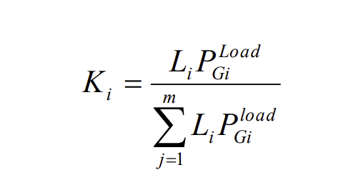
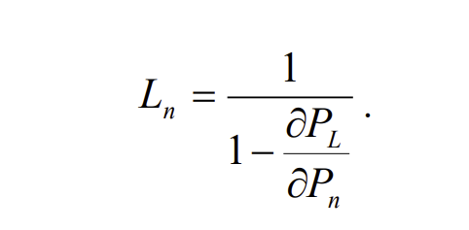
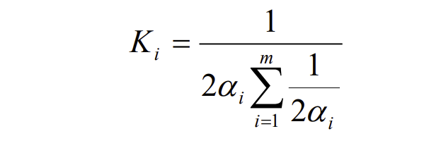
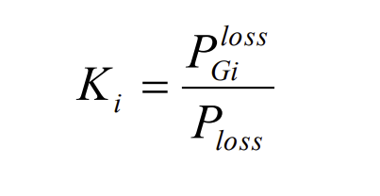
Economic Load Dispatch (ELD)
Participation Factor
Distance
Cost Function
Generation Capacity
Notes:
Here are some popular ways to define the participation factor. We can define the participation factor in multiple ways so that it best matches the physical system and the problem schema. One thing to be kept in mind is that the sum of the participation factors should be 1, which means that the system’s loss is not changing, but redistributing.
Distance: L is a penalty factor which is defined to counter the losses due to different distances from the demand point. While distributing the power to all the buses, the closer generators will have less cost than the farther ones in terms of transmission losses, so the closer the generators are, the larger the participation factor is.
Cost function:
with the cost function is approximated as a quadratic relation with active power, i.e. cost = alphaP^2+betaP+gamma, the generator with less cost will allotted more losses.
Generation capacity:
The bigger the capacity, the more efficient it becomes for a constant loss. With the increase in size, cost of production decreases. It is advantageous to give preference to a bigger generator when distributing the load.

Slide 6
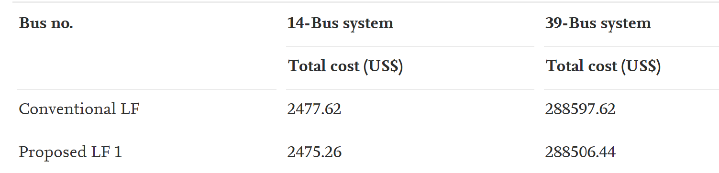
Economic Load Dispatch (ELD)
Generator | Single Slack Bus Variation (MW) | Distributed Slack Bus Generation Variation (MW) | Distributed Slack Bus Load Variation(MW)
1 | 77.324 | 77.610 | 77.612
2 | 133.875 | 132.715 | 132.726
3 | 120.724 | 120.954 | 130.970
... | ... | ... | ...
λ ($/pu MW-hr) | 382.758 | 301.114 | 326.421
Notes:
Here are the main results for the modified ELD problems. The top one is using generation cost as the determinant for participation factors.
some key outcomes:
1: The distributed slack bus algorithm is more economic, but not significantly. It is understandable since the new power flow equation is just REDISTRIBUTING the loss but not reducing the loss
2: The variance does not change very much based on the size of the system, but there is still a trend that with more generators in the system, the redistribution of losses can take place more economically
3: what is important is how the participation factor contributes to the change in the power flow sensitivity
This is shown in the table below. This result comes from a case study where the economic optimal dispatch is studied.
The importance of changing the load-flow formulation such that the slack-bus constraint is no longer required is illustrated. The lamda value depends on how the participation factor is selected. For a demand change, through a corresponding definition of participation factor, a system lamda value is obtained which represents the true minimal incremental cost change incurred by optimally changing all the generation units. Single Slack bus power flow does not represent this cost change per unit demand change unless the demand change occurs on the slack bus.

Slide 7
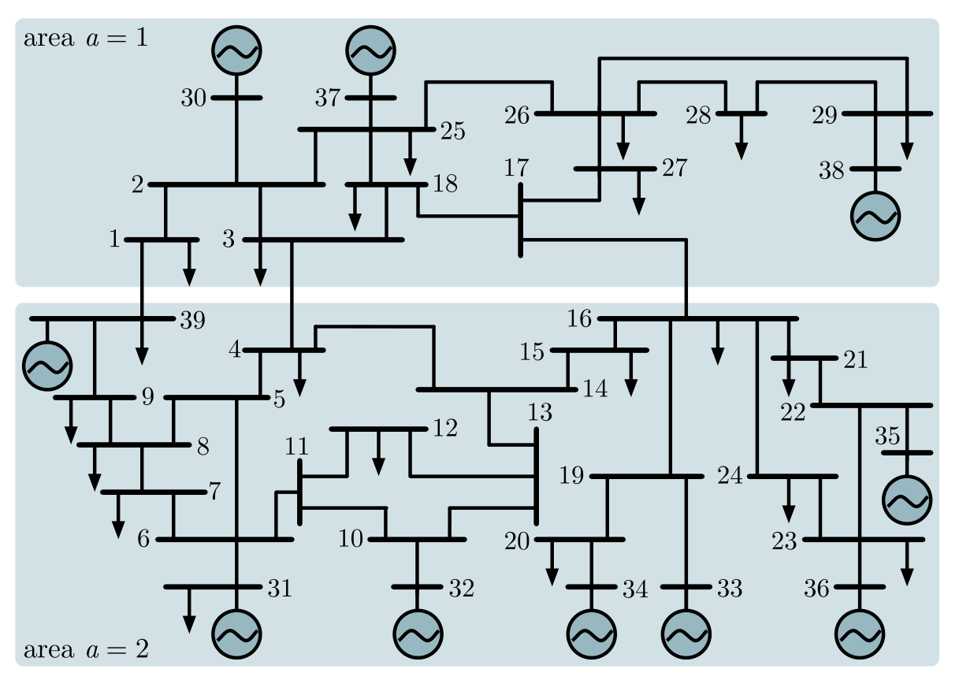
Automatic Generation Control (AGC)
Participation Factor: weighted average of AGC quantity in auxiliary service market
New England 39-bus 10-machine test system

Slide 8
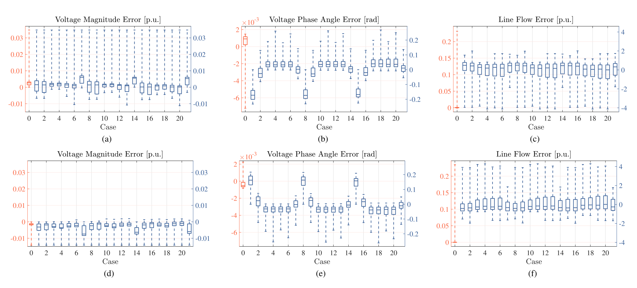
Automatic Generation Control
IEEE 30 bus system: transmission loss reduction

Slide 9
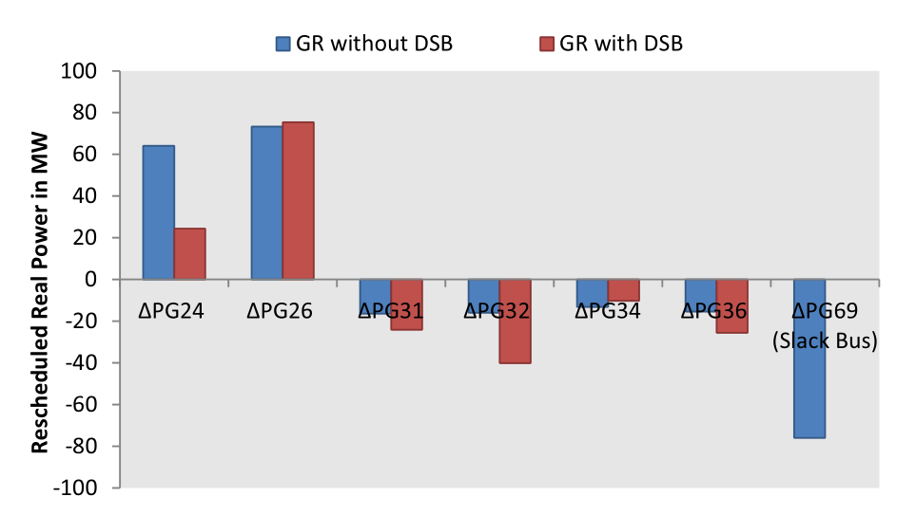
Congestion Management (CM)
Participation Factor: Weighted average of max MW rating of machines
IEEE 30, IEEE 108 bus test systems

Slide 10
Congestion Management (CM)
 | GR w/o distributed slack bus | GR with distributed slack bus
Congestion management cost ($/hr) | 7874.19 | 3344.58
Real power loss (MW) | 11.31 | 6.512

Slide 11
Conclusion
Single Slack Bus Algorithm has limitations
Distributed Slack Bus Algorithms are investigated in problems such as ELD(EOD), AGC, CM etc
There are improvements but not significant
Future in Autonomous Energy Grids
Multi-Level Control
Dynamic situations

Slide 12
Citation
Jang,Gwang Soo, et al. “A modified power flow analysis to remove a slack bus with a sense of economic load dispatch.” Electric power systems research 73.2 (2005): 137-142
Dhople, Sairaj V., et al. “Reexamining the distributed slack bus.” IEEE Transactions on Power Systems 35.6 (2020): 4870-4879
Mohapatra, Anurag. Distributed slack bus algorithm for economic load dispatch. Diss. 2012
Meisel, Jerome. “System incremental cost calculations using the participation factor load-flow formulation.” IEEE Transactions on Power Systems 8.1 (1993): 357-363
Chayakulkheeree, K. "Application of distributed slack bus power flow to competitive environments," 2007 Australasian Universities Power Engineering Conference, 2007, pp. 1-6, doi: 10.1109/AUPEC.2007.4548081.
Sugathi, S.T., et al. “Optimal generator rescheduling with distributed slack bus model for congestion management using improved teaching learning based optimization algorithm” Sādhanā 43, 181 (2018).

